Slide 1
Professional
and Societal Context of Engineering Design

Slide 2
Role of engineering in society

Slide 3
Engineering is one of the key influences that shapes our society.
Engineers don’t just work with machines, designs and electronics, they use maths and science to provide innovation and inventions that shape our society and improve the way we live and work.
Engineers are creative problem solvers.

Slide 4
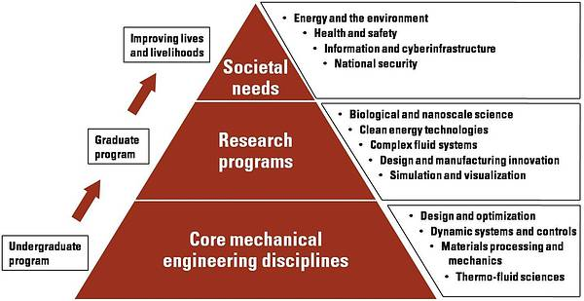

Slide 5
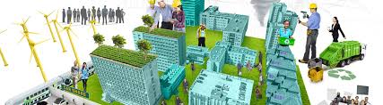
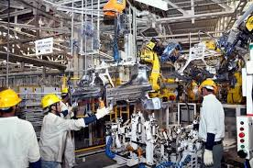
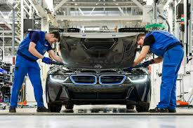


Why engineers are so important?
Civil engineer
Mechanical engineer
Automotive
Software engineer
Electrical engineer

Slide 6
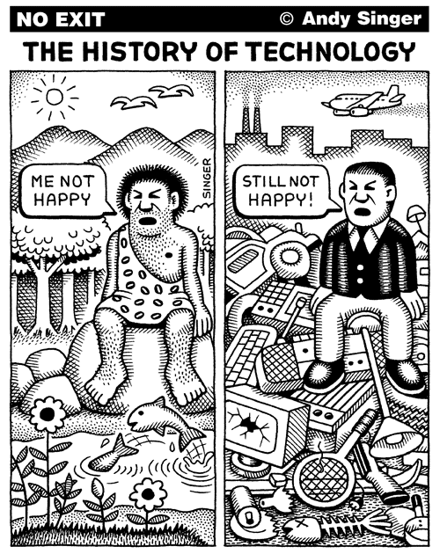
Significant Developments in Society using Technology

Slide 7



Education & learning

Slide 8




Communication methods

Slide 9



Healthcare monitoring

Slide 10
Role of engineers in society

Slide 11
About Engineering :
Engineering is one of the key influences that shapes our society. Engineers don’t just work with machines, designs and electronics, they use math and science to provide innovation and inventions that shape our society and improve the way we live and work. This means that engineers have a responsibility and also a great opportunity to ensure that the have a positive influence in society.

Slide 12
Types of engineering:
Aerospace Engineering- The design of aircraft, spacecraft and everything concern with the flying stuffs .
Chemical Engineering – The exploitation of chemical principles in order to carry out large scale chemical process, as well as designing new specialty materials and fuels, without this fields ,any of these fields cant proceed.
Civil Engineering – The design and construction of public and private works, such as infrastructure, bridges and buildings.
Electrical Engineering – the design and study of various electrical & electronic systems, such as electrical circuits , electronic devices , electronics circuits , optical fiber , computer systems etc.
Mechanical Engineering – The design of physical or mechanical systems, such as engines, compressor, powertrains, Vibration isolation equipment, the most popular amongst all of these and so-called the ‘ever green field ‘ .
For each of these fields there exists considerable overlap, especially in the areas of the application of sciences to their disciplines such as physics, chemistry and mathematics.

Slide 13
Problem solving :
Engineers use their knowledge of science, mathematics, logic, and appropriate experience to find suitable solutions to a problem. Engineering is considered a branch of applied mathematics and science. Creating an appropriate mathematical model of a problem allows them to analyze it (sometimes definitively), and to test potential solutions.
Usually multiple reasonable solutions exist, so engineers must evaluate the different design choices on their merits and choose the solution that best meets their requirements. Genrich Altshuller, after gathering statistics on a large number of patents, suggested that compromises are at the heart of “low-level” engineering designs, while at a higher level the best design is one which eliminates the core contradiction causing the problem.
Engineers typically attempt to predict how well their designs will perform to their specifications prior to full-scale production. They use, among other things: prototypes, scale models, simulations, destructive tests, nondestructive tests, and stress tests. Testing ensures that products will perform as expected.

Slide 14
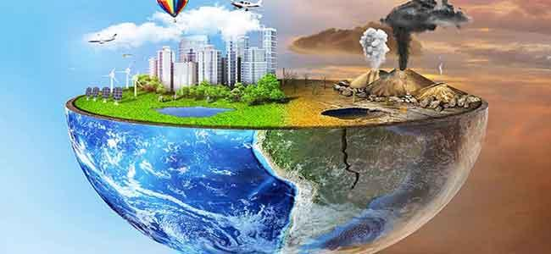
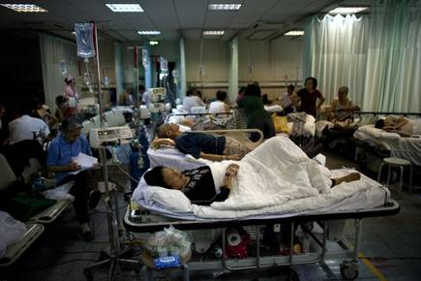
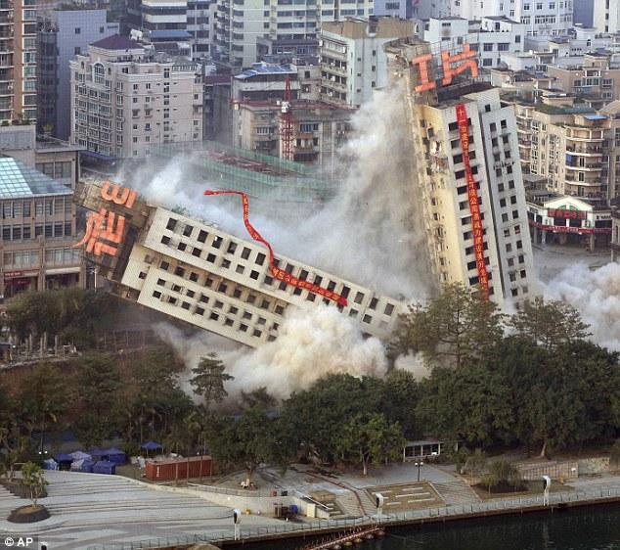
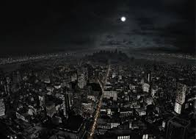
RESPONSIBILITY OF ENGINEERING DESIGN TOWARDS SOCIETY
Imagine what life would be like without pollution controls to preserve the environment, life-saving medical equipment, or low-cost building materials for fighting global poverty. All this takes engineering. In very real and concrete ways, engineers save lives, prevent disease, reduce poverty, and protect our planet.

Slide 15
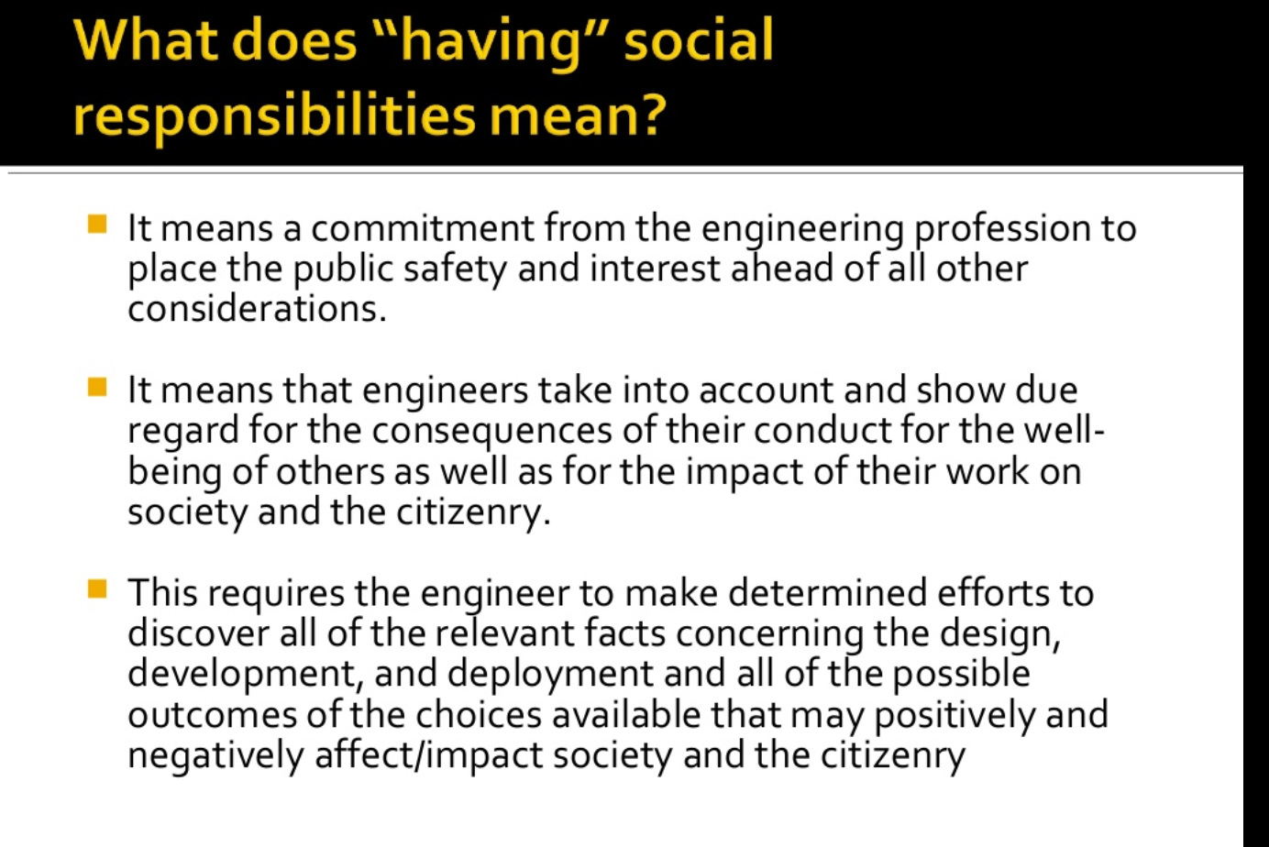

Slide 16
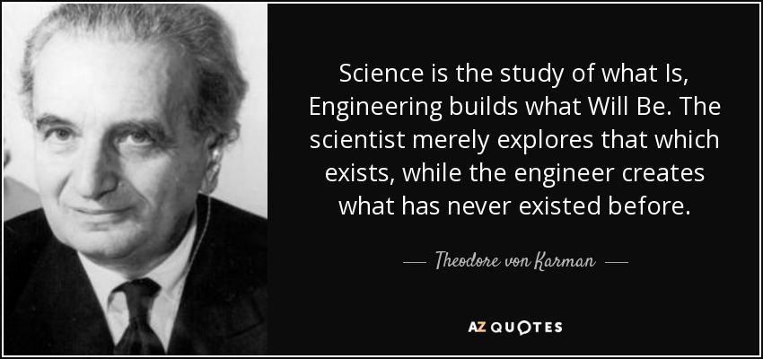
Engineering design contribute considerably to the quality of life in society and it is important that they articulate their role clearly and firmly. Without Engineering design we can’t even think about getting so modernized world , where almost every person depends on Technology . Engineers create new innovation stuff just by their different way of thinking from the common man and by their skills , dedication and hard work they create something new or improve the products.

Slide 17

Engineers as professionals
Let’s move towards the next topic →

Slide 18
Understanding the term Engineer’s
Person who has the ability to:
invent something
design it properly
analyze the problem
build and test machines
understand and build complex systems
understand and build structures
build gadgets and materials
to fulfil functional objectives and requirements.
All of these while considering limitations imposed:
practically
regulation
safety
cost

Slide 19
Understanding the term ‘professional’
Something that requires a high level of training in their domain.
We say to do things that shows skill, training or care

Slide 20
‘Engineers’ as “Professionals”
An engineer having all the ability is not sometimes enough but also when to use which one is matters most and also describes how much you are able to get something.
This is the case with engineers not all engineers are termed as professionals or not a some random person pronounced to be.
Someone who actually capable of being that termed that like how?
Those engineers have a more experienced gather and understand the actual usage of skills and also have a more understanding the people’s mind as at last people are developing for people’s only.
So we have that thought in our mind that whatever we are building it must proved more helpful and more updated solution for the existing one.

Slide 21

ENGINEERING DESIGN ETHICS

Slide 22


WHAT ARE ETHICS ?
“The science of the sources, principles, sanctions, and ideals of human conduct and character; the science of the morally right.”
HOW DO THEY APPLY IN ENGINEERING DESIGN ?
Engineering design ethics concern issues that arise during the design of technological products, processes, systems, and services.
This includes issues such as safety, sustainability, user autonomy, and privacy.
Design choices influence how ethical issues are addressed in technology.

Slide 23
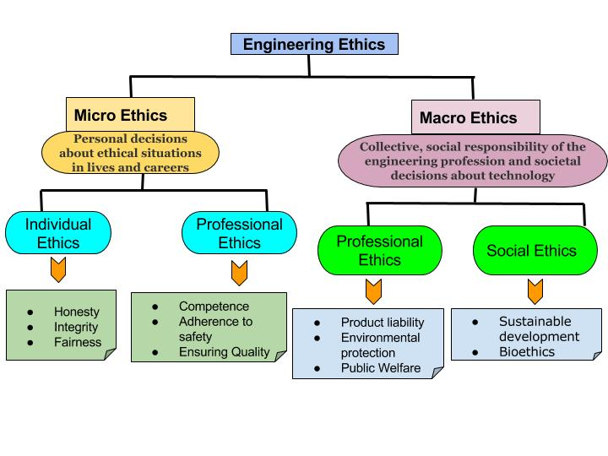
MORAL QUESTIONS DESIGNERS NEED TO THINK ABOUT
WHAT ARE THE LONG-TERM PROBLEMS FACING THE INDUSTRY YOU’RE DESIGNING FOR ?
HOW DOES YOUR DESIGN PROBLEM CONTRIBUTE TO THEM ?
AT WHAT ENVIRONMENTAL, CULTURAL, AND SOCIAL COST DOES YOUR DESIGN SOLUTION COME ?
WHO IS YOUR DESIGN SOLUTION SERVING, AND WHO DOES IT NOT SERVE ?
ARE YOUR TEAM AND TESTING REPRESENTATIVE OF THE POPULATIONS IMPACTED ?
HOW DOES YOUR SOLUTION PLAY INTO YOUR USERS’ VALUES, PREFERENCES AND BEHAVIOURS ?

Slide 24
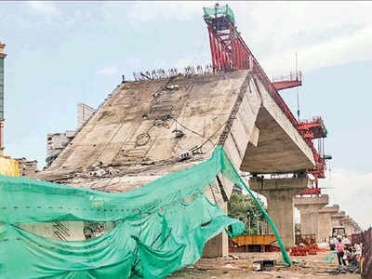
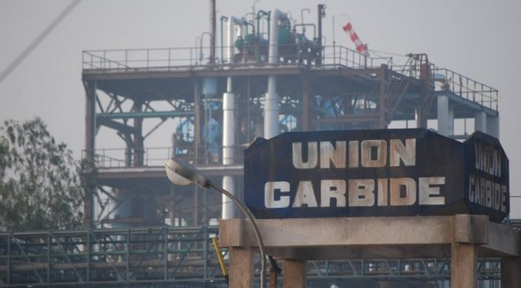
GURUGRAM FLYOVER COLLAPSE
Design and quality of materials used is compromised
Faults in the structure lead to weakened strength
Poor quality materials used due to low cost
Unforeseen growth in traffic intensity
Quality of work affected in order to meet deadlines
UNION CARBIDE PESTICIDE PLANT
Bhopal Gas Tragedy – ignorance and negligence
Risking the health of workers in manufacturing and production units as well as the society
Maximizing profit at the cost of human lives
Safety systems designed were inadequate to prevent this disaster

Slide 25

Important Ethical Theories
-by Kumar Prakhar

Slide 26
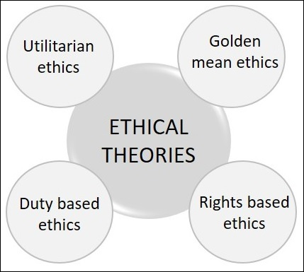
Types of Ethical Theories
Depending upon the ethics a person is intended to follow, four theories were postulated by four different philosophers. These theories help to create the fundamentals of obligation suitable and applicable to professional and personal conduct of a person in his everyday life.

Slide 27
Golden Mean
The Golden Mean ethical theory was proposed by Aristotle. According to this theory, the solution to a problem is found by analyzing the reason and the logic.
For example, the solution to the problem of environment pollution is neither by avoiding industrialization and civilization, nor by neglecting the environment completely. A mean solution that will work towards controlling the pollution and protecting the environment will also help.
Problem in Application
The application of this theory varies from one person to another with their powers of reasoning and the difficulty in applying the theory to ethical problems.

Slide 28
Rights-based Ethical Theory
The Rights based ethical theory was proposed by John Locke. According to this theory, the solution to a problem is by realizing that every person has a right to live. Live and let live is the philosophy behind this theory.
For example, any action in terms of Capital punishment, Jails, Income taxes and Medical charges etc. come under this category.
Problem in Application
One rights of a person may conflict with rights of the other.

Slide 29
Duty-based Ethical Theory
The duty-based ethical theory was proposed by Immanuel Kant. According to this theory, every person has a duty to follow which is accepted universally, with no exceptions.
An example of this can be expecting all to be honest, kind, generous and peaceful.
Problem in Application
The universal application of this theory can be misleading.

Slide 30
Utilitarian Ethics
The Utilitarian ethics was proposed by John Stuart. According to this theory, the happiness or pleasure of a greatest number of people in the society is considered as the greatest good. According to this philosophy, an action is morally right if its consequences lead to happiness of people and wrong if they lead to their unhappiness.
An example of this can be the removal of reservation system in education and government jobs, which can really benefit the talented. But this can have an impact on the rights of the minorities.
Problem in Application
Qualification of the benefits can be difficult.

Slide 31
Engineering: Code of Ethics (excerpt of eci)

Slide 32

Engineering council of india
Engineering Council of India (ECI) is an apex body of engineering associations in India. It is the Apex Body of engineering profession in India, by coming together of a large number of Professional Organizations /Institutions of Engineers to work for the advancement of engineering profession in various disciplines and for enhancing the image of engineers in society, by focusing on quality and accountability of engineers.

Slide 33
OTHER GOVERNING ASSOCIATIONS
Niti Aayog
Indian Institution Of Industrial Engineering
All India Council For Technical Education (AICTE)
Indian Institution Of Plant Engineers
National Board Of Accreditation (NBA), (AICTE)
Indian National Group Of The IABSE
Central Public Works Department (Ministry Of Urban Development)
Indian Society For Non-Destructive Testing
Department Of Commerce, Ministry Of Commerce & Industry
Indian Society For Technical Education
Department Of Secondary And Higher Education, Ministry Of HRD
Indian Society For Trenchless Technology
Department Of Scientific And Industrial Research, Council of Scientific & Industrial Research

Slide 34
Two Dimensions of Ethics in Engineering
Ethics is part of engineering for two main reasons.
Engineers need to be socially responsible when building products and processes for society.
Social responsibility requires professional responsibility.

Slide 35
Article 1. Social Responsibility to Uphold Ethical Values of the Society:
1.1 Public Safety
1.2 Compliance with Social Order
1.3 Impartiality and Fairness
1.4 Environment Protection & Improvement

Slide 36
Article 2. Responsibility to Maintain High Standards of Professional Quality.
2.1 Development of Technical and Managerial Skills
2.2 Undertake Assignment where Professionally Competent
2.3 Performance Responsibility
2.4 Proper Verification of Documents and Production Processes

Slide 37
Article 3. Obligation to Maintain High Standard of Personal Behaviour in a Responsible Manner
3.1 Honesty and Integrity in Professional Dealing
3.2 Compensation for Services Rendered
3.3 Professional Opinion
3.4 Professional Relationship with the Employer
3.5 Information Communication with Employers
3.6 Mutual Obligation & Trust
3.7 Self Promotion
3.8 Employers’ Business Secrets
3.9 Personal Conflict

Slide 38
THANK YOU

Slide 39
GROUP MEMEBERS:
PRANJAL ROY 19BAI10008
KUMAR PRAKHAR 19BAI10012
SHANZEH BATOOL 19BAI10017
VIKANKSH GAUTAM 19BAI10024
NIMESH SRIVASTAVA 19BAI10026
ADEEL ZIA ANSARI 19BAI10046
KISHAN KUMAR 19BAI10066
RASHMI RAWAT 19BAI10077

